Slide 1

Still birth among moms with Covid-19
Article by Anthony King (Apr. 23, 2021)
Presented by Derek Scholes

Slide 2
Background
Coronavirus has been transmitted from the mother to the fetus through the placenta. This has been detected by using an antibody (immunohistochemistry) against SARS-CoV2 on a microscopic section of placenta.
D. MOROTTI ET AL., "MOLECULAR PATHOLOGY ANALYSIS OF SARS-COV-2 IN SYNCYTIOTROPHOBLAST AND HOFBAUER CELLS IN PLACENTA FROM A PREGNANT WOMAN AND FETUS WITH COVID-19. PATHOGENS, 10:479, 2021.
Six women in Ireland suffered stillbirths related to SARS-CoV2 infections (a few weeks after) and one miscarriage. Five of the cases included he B.1.1.7 variant (UK origin & 94% of cases).
Each case showed extensive damage to the placenta.
“The placentas look completely burnt out, just incredibly necrotic and damaged,” says Keelin O’Donoghue, an obstetrician at Cork University Maternal Hospital in Ireland who is part of team preparing a manuscript on the cases. “They all have suffered acute injury, which is why you have an acute effect in terms of fetal compromise or death.”

Slide 3
Background (cont.)
Three cases of emergency deliveries caused by severely degraded placentas in mothers diagnosed with COVID 19.
“There’s a very abnormal appearance” to the surface of the placenta when it is cut for examination, says Brendan Fitzgerald, a pathologist at Cork University Hospital who has examined five of the affected placentas, “with white streaks and nodules occupying large portions of the placental disk. It is a very uncommon finding that we would rarely see in routine practice.”
https://www.the-scientist.com/features/human-fetuses-can-contract-sars-cov-2-but-its-rare-68293
The Royal College of Physicians in Ireland released a statement on April 13: “The six cases are on a background of a total of 11 cases of SARS-CoV-2 placentitis identified in Ireland since the start of the pandemic. Results to date, from the baby’s deaths, indicate a link with the B.1.1.7 variant of concern which may explain why this finding was not a significant feature of the 1st and 2nd waves in 2020.”

Slide 4
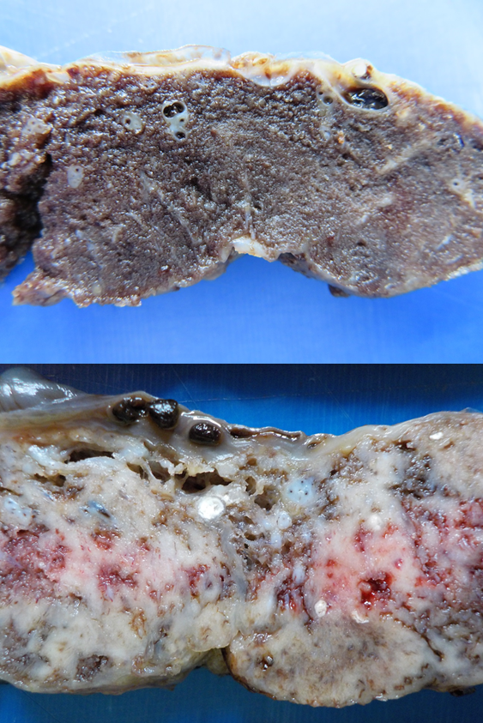
Placental Damage
Almost no evidence that the fetus contracted the disease because all infants were normally grown and formed.
The syncytiotrophoblast has been the most affected area where the ACE2 receptors are expressed
Possible enhanced binding of variant
Top: Normal placenta
Bottom: SARS-CoV2 infected placenta
Histiocytic intervillositis
Clumping of villi and accumulation of fibrin and necrotic material

Slide 5
Placental Damage (Results)
Pathological findings from the Medical College of Georgia reports 11 placentas from 5 countries which were reported to have SARS-CoV infection prior to birth, all with similar findings as previously stated.
Five came from liveborn infants whiles six came from stillborn or terminated infants
Roberts suspects the virus itself damages the placenta. “I don’t think that it is just the inflammatory cells that caused the necrosis of the trophoblasts, because the usual type of noninfectious CHI is not associated with trophoblastic necrosis.”
“From our experience, only about 1% of placentas from women who test positive by PCR at the time of delivery shows this pathology,” Larisa Debelenko notes
“A proper statistical analysis comparing the incidence of spontaneous abortions pre-[COVID-19] and during the epidemic may provide a better understanding of effects of the virus on pregnancy outcomes.”

Slide 6
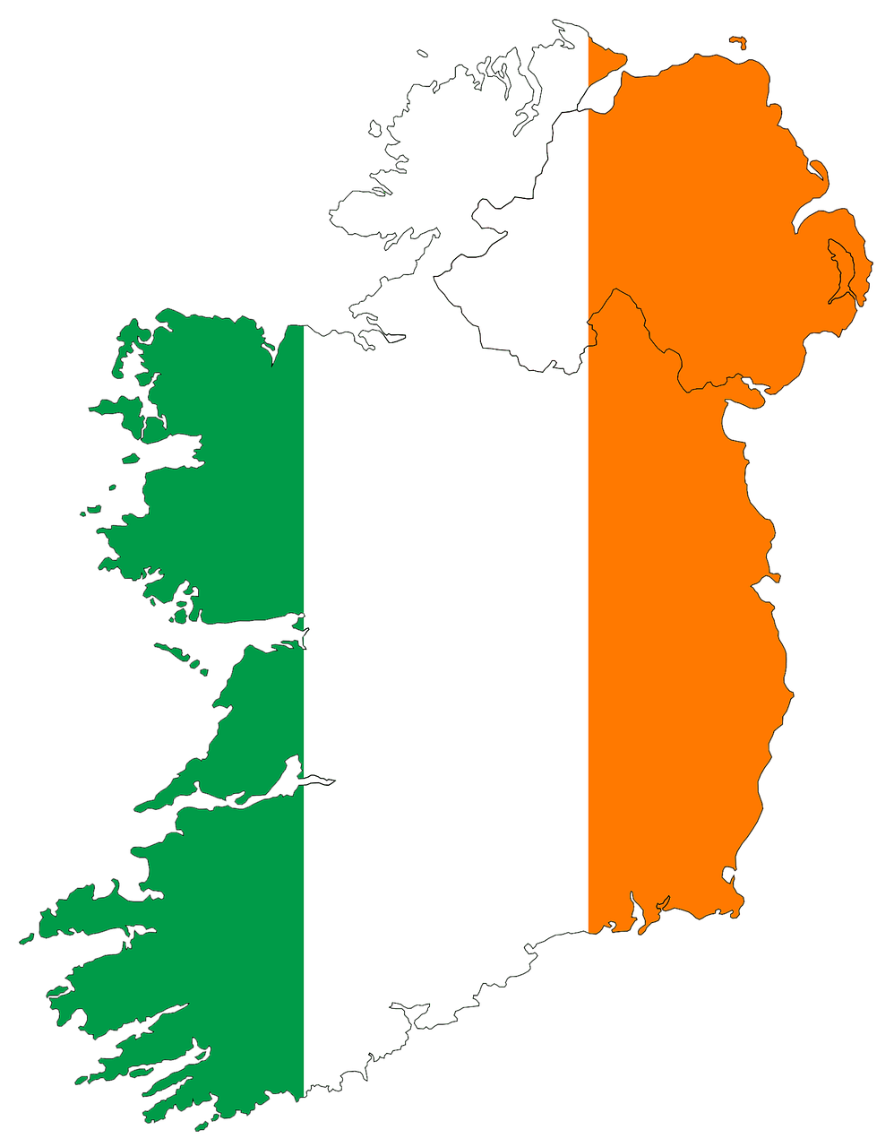
Demographics
Study 1: Ireland – 6 women
Study 2: Ireland – 11 cases of placentitis (5 livebirths, 6 stillbirths/miscarriages)
Incidence rate: 1/100 to 1/200 stillbirths
Study 3: Ireland – 1 woman (livebirth via Caesarean at 36 weeks due to decreased fetal movement)
Study 4: 11 placentas from 5 different countries (5 livebirths, 6 stillbirths or terminated infants)
Study 5: 150 women – 75 infected and 75 controls
1% show positive for pathology from women who test positive by PCR

Slide 7
Conclusion
Chances of placentitis occurs in about 1 in 100 women who test positive for COVID 19, most commonly with the B.1.1.7 variant.
Pathology includes syncytiotrophoblast cell necrosis with clumping of placental villi. There is a large accumulation of fibrin and necrotic material.
Statistical analysis comparing pre-COVID-19 spontaneous abortions and those during the pandemic should be performed to help proved an improved understanding of how the virus effects the outcomes of pregnancy.

Slide 8
Reference
King A. Doctors Investigate Several Stillbirths Among Moms with COVID-19. The Scientist. April 2021. https://www.the-scientist.com/news-opinion/doctors-investigate-several-stillbirths-among-moms-with-covid-19-68703. Accessed June 8, 2021.

